Slide 1
Please Activate your Tableau Desktop TDFJ-4C26-8C10-5216-3CEA

Slide 2
Visual Analytics
KJ Kim
Product Consultant

Slide 3

Notes:
Color
Applied perception
Algorithms for design
Vision and visualization
Visual Data Analysis Workflow
Spatial Visualization
Map Projections
Perception and Cognition
Data Storytelling
Visualization Techniques

Slide 4
1. Human Visual Perception 2. Visual Best Practice 3. Visual Analysis 4. Guided Analytics 5. Good Dashboard Design

Slide 5
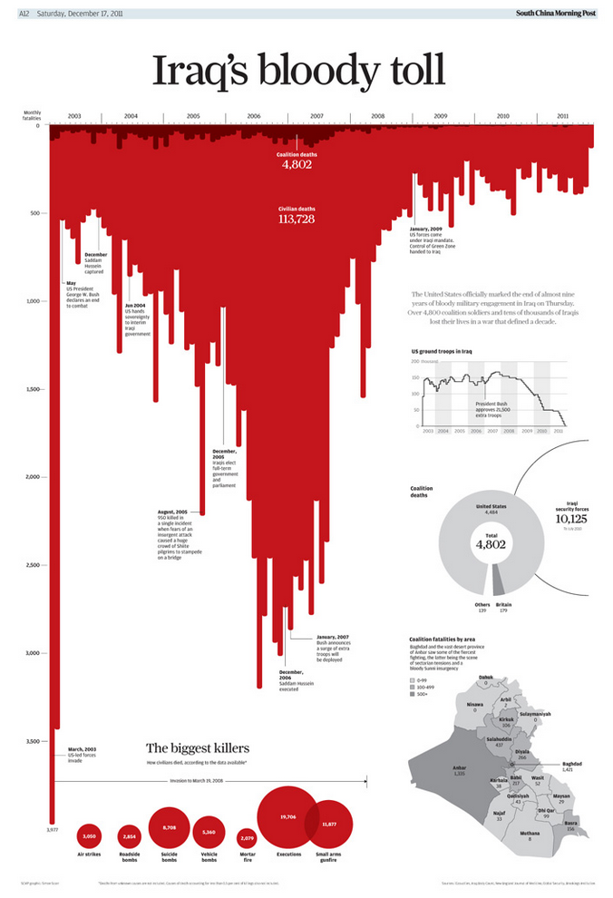
Notes:
South China Morning Post
Simon Scarr
Multi-award winning
Shows deaths from start to beginning end US soldiers in Iraq
Each bar = deaths per month, 2003-2011 (beginning of withdrawal)

Slide 6
Iraq: Deaths on the decline
Notes:
Bars.
Colour.
Now I see decline
Change title.
PAUSE

Slide 7
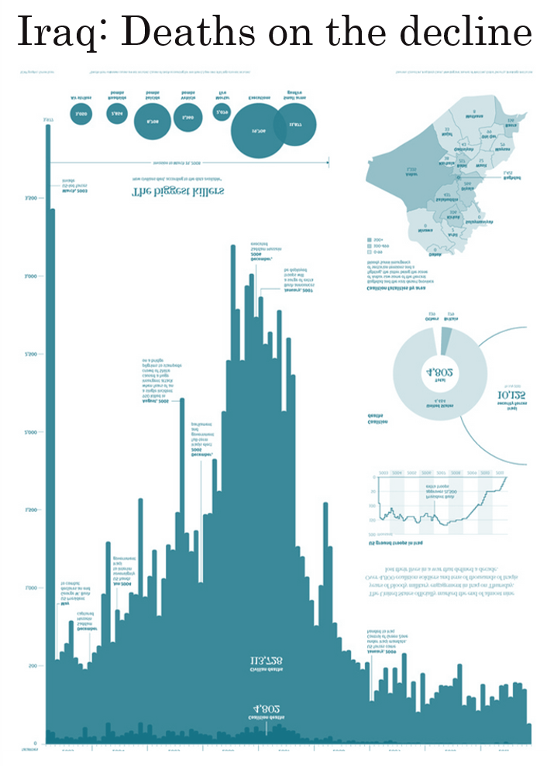
Iraq: Deaths on the decline
Notes:
Isn’t this incredible.
Using visual attributes I CHANGED THE POINT OF VIEW.
NOT DECEPTIVELY

Slide 8
1. Human Visual Perception 2. Visual Best Practice 3. Visual Analysis 4. Good Dashboard Design 5. Guided Analytics

Slide 9
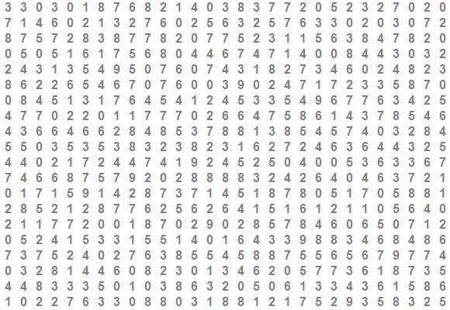
Notes:
I like to start these sessions off with a game I call “count the nines.” So, count the nines. Raise your hand when you think you know how many nines there are on here. [pause] In fact, just go ahead and shout it out. If you know how many nines are on here, shout out the answer. [pause]

Slide 10
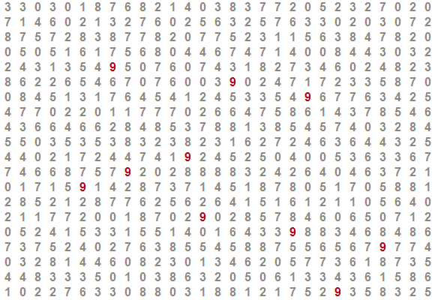
Notes:
NOW count the nines. How many nines do you see? Raise your hand when you know.

Slide 11
“Visual analytics is the representation and presentation of data that exploits our visual perception abilities in order to amplify cognition.”
Andy Kirk
Author
“Data Visualization: a successful design process”
Notes:
Those are really fancy words for what you just experienced. Humans can see visual patterns very well, but only when the patterns really play to a human’s strengths.

Slide 12
Perception Process
Stage 1
Parallel
Stage 2
Serial
Stage 3
Goal-directed processing
Shapes
Pre-attentive
Pattern recognition
Gestalt Principle
Objects held in visual memory
Attention-driven
Colour
Spatial
Movement
Notes:
Spatial- Paragraphs in text
Pre-attentive – Unconscious accumulation of information
Gestalt Principle – “Unified Whole”
7+2-2 magic number – Capacity for processing information

Slide 13

What is Pre-attentive Processing?
Occurs before consciousness
Pops out
Notes:
Preattentive attributes are information we can process visually almost immediately, before sending the information to the attention processing parts of our brain.
This is information we process and understand almost unconsciously.
These are generally the best ways to present data, because we can see these patterns without thinking too hard.
Within 200-250ms
http://www.youtube.com/watch?feature=player_detailpage&v=wnvoZxe95bo

Slide 14

Change Blindness
Notes:
http://www.youtube.com/watch?feature=player_detailpage&v=wnvoZxe95bo
Magician uses change blindness
Psychological Phenomenon that occurs when change in visual stimulus goes unnoticed. Observers often fail to notice major differences introduced into an image while it flickers off and on again.

Slide 15
Pre-attentive visual attribute
Orientation
Line Width
Line Length
Curved/Straight
Colour/Hue
Enclosure
Size
Shape
2D Position
Intensity
Notes:
Support perceptual inference
Enhance detection and cognition
Needs testing with target audience to see if it can perform required tasks
Pre-attentive Processing is central to how we understand visual distinctiveness.
Processing is pre-attentive when time taken to find the target is equally fast no matter how may distracting non-targets are there.
Anything processed at a rate faster than 10ms per item is considered to be pre-attentive. (40ms for non-preattentive)
Preattentive attributes are information we can process visually almost immediately, before sending the information to the attention processing parts of our brain. This is information we process and understand almost unconsciously. These are generally the best ways to present data, because we can see these patterns without thinking too hard.
If you have time/Internet/sound, show this video: http://www.youtube.com/watch?feature=player_detailpage&v=wnvoZxe95bo
WHY?
To show things at a glance. POP OUT

Slide 16
Text is not pre-attentive
SUBJECT PUNCHED QUICKLY OXIDIZED TCEJBUS DEHCNUP YLKCIUQ DEZIDIXO
CERTAIN QUICKLY PUNCHED METHODS NIATREC YLKCIUQ DEHCNUP SDOHTEM
SCIENCE ENGLISH RECORDS COLUMNS ECNEICS HSILGNE SDROCER SNMULOC
GOVERNS PRECISE EXAMPLE MERCURY SNREVOG ESICERP ELPMAXE YRUCREM
CERTAIN QUICKLY PUNCHED METHODS NIATREC YLKCIUQ DEHCNUP SDOHTEM
GOVERNS PRECISE EXAMPLE MERCURY SNREVOG ESICERP ELPMAXE YRUCREM
SCIENCE ENGLISH RECORDS COLUMNS ECNEICS HSILGNE SDROCER SNMULOC
SUBJECT PUNCHED QUICKLY OXIDIZED TCEJBUS DEHCNUP YLKCIUQ DEZIDIXO
CERTAIN QUICKLY PUNCHED METHODS NIATREC YLKCIUQ DEHCNUP SDOHTEM
SCIENCE ENGLISH RECORDS COLUMNS ECNEICS HSILGNE SDROCER SNMULOC

Slide 17
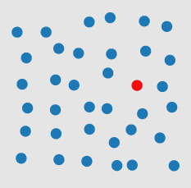

Can you see the red dot?
Colour is pre-attentively processed

Slide 18
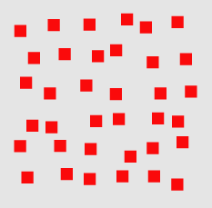
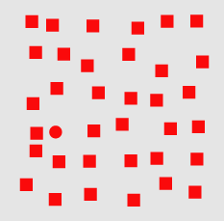
Can you see the red dot?
Shape is pre-attentively processed

Slide 19
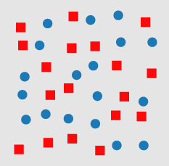
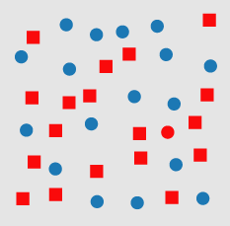
Can you see the red dot?
Conjunction of 2 properties is usually not pre-attentive

Slide 20
More Accurate
Position
Length
Width
Slope
Gap
Size
Judging Magnitudes
Volume
Large Gap
Color/Hue
Color/Density
Less Accurate

Slide 21
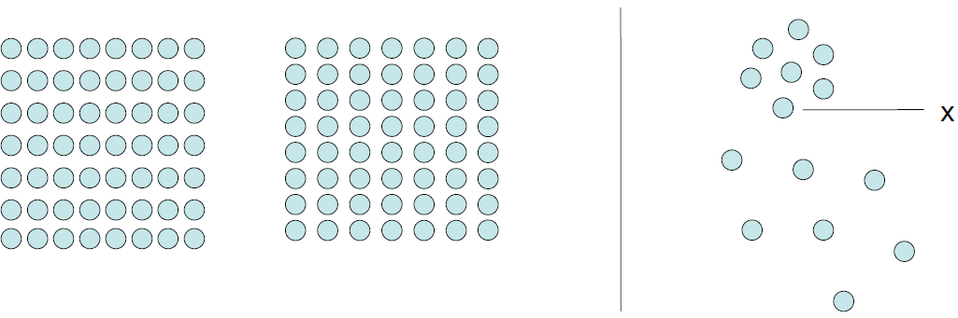
Gestalt Principle
Proximity
Notes:
People tend to organize visual elements into groups or unified wholes when certain principles are applied.
Elements close together are perceived together.

Slide 22
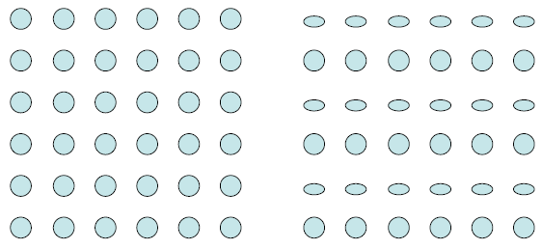
Gestalt Principle
Similarity

Slide 23
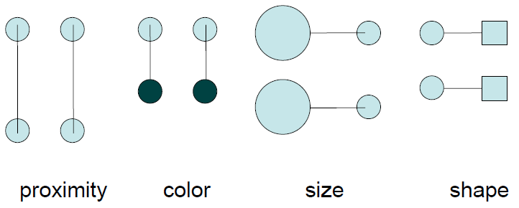
Gestalt Principle
Connectedness

Slide 24



Gestalt Principle
Continuity
Symmetry
Contour
Notes:
Movement of our eyes

Slide 25
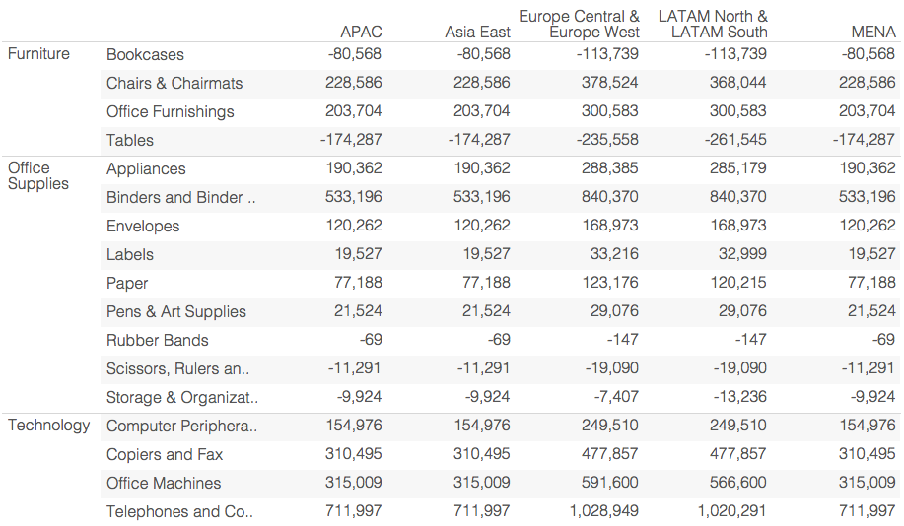
Text is not a pre-attentive attribute
Notes:
Brains are good at coordinating parts that work together
Which products are the most unprofitable. Scan the whole table.

Slide 26
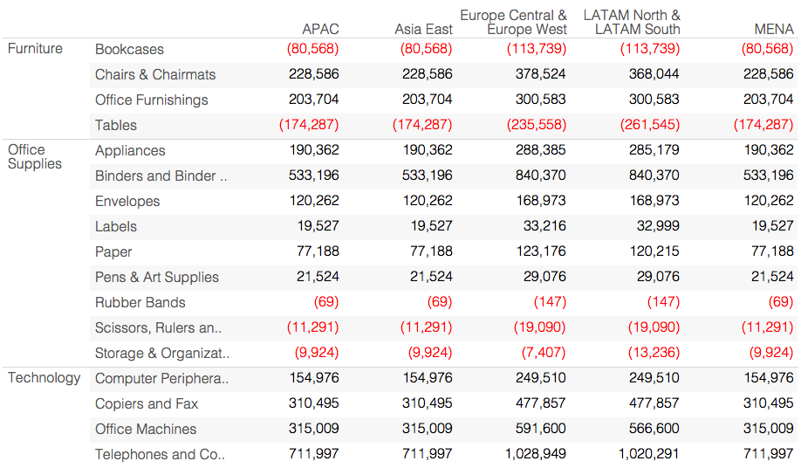
We are faster at ‘seeing’ data
Notes:
Using colour encoding we light up another part of our brain that recognises shapes and colour.
Double encoding colour and parentheses.
Accountants might be smarter than we think

Slide 27
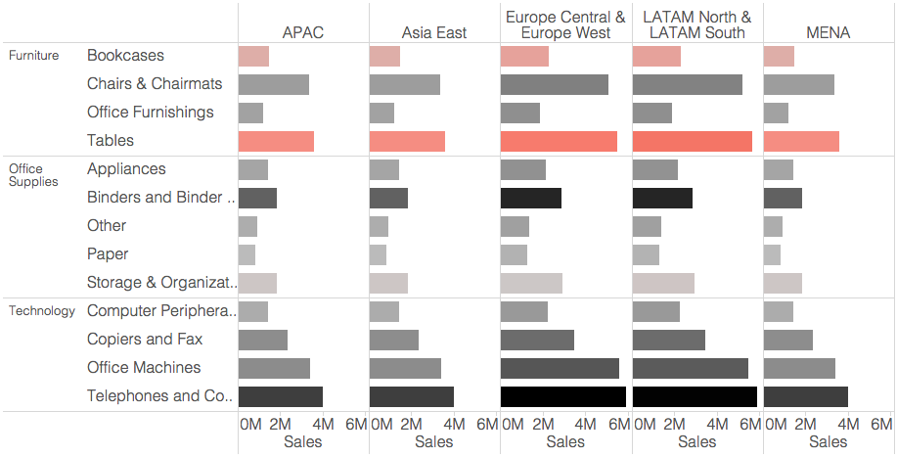
Color to highlight a problem
Notes:
We took advantage of colour and shape
Add length
Continuous colour encoding for profit

Slide 28
Let’s Look at Some Data
I |  | II |  | III |  | IV
x | y | x | y | x | y | x | y
10 | 8.04 | 10 | 9.14 | 10 | 7.46 | 8 | 6.58
8 | 6.95 | 8 | 8.14 | 8 | 6.77 | 8 | 5.76
13 | 7.58 | 13 | 8.74 | 13 | 12.74 | 8 | 7.71
9 | 8.81 | 9 | 8.77 | 9 | 7.11 | 8 | 8.84
11 | 8.33 | 11 | 9.26 | 11 | 7.81 | 8 | 8.47
14 | 9.96 | 14 | 8.1 | 14 | 8.84 | 8 | 7.04
6 | 7.24 | 6 | 6.13 | 6 | 6.08 | 8 | 5.25
4 | 4.26 | 4 | 3.1 | 4 | 5.39 | 19 | 12.5
12 | 10.84 | 12 | 9.13 | 12 | 8.15 | 8 | 5.56
7 | 4.82 | 7 | 7.26 | 7 | 6.42 | 8 | 7.91
5 | 5.68 | 5 | 4.74 | 5 | 5.73 | 8 | 6.89
Notes:
Let’s see another example. Here’s some data. The are 4 sets of data here, each with 11 sets of x-y coordinates.
For the purposes of this exercise, assume x data is number of trips and y is total earnings per day per driver. This is segmented by the different regions you guys are operating in.
Is this similar to the type of analysis you guys encounter? What additional questions come up for you?

Slide 29
Let’s Analyze Some Data
I |  | II |  | III |  | IV
x | y | x | y | x | y | x | y
10 | 8.04 | 10 | 9.14 | 10 | 7.46 | 8 | 6.58
8 | 6.95 | 8 | 8.14 | 8 | 6.77 | 8 | 5.76
13 | 7.58 | 13 | 8.74 | 13 | 12.74 | 8 | 7.71
9 | 8.81 | 9 | 8.77 | 9 | 7.11 | 8 | 8.84
11 | 8.33 | 11 | 9.26 | 11 | 7.81 | 8 | 8.47
14 | 9.96 | 14 | 8.1 | 14 | 8.84 | 8 | 7.04
6 | 7.24 | 6 | 6.13 | 6 | 6.08 | 8 | 5.25
4 | 4.26 | 4 | 3.1 | 4 | 5.39 | 19 | 12.5
12 | 10.84 | 12 | 9.13 | 12 | 8.15 | 8 | 5.56
7 | 4.82 | 7 | 7.26 | 7 | 6.42 | 8 | 7.91
5 | 5.68 | 5 | 4.74 | 5 | 5.73 | 8 | 6.89
Property | Value
Mean of x in each case | 9 (exact)
Variance of x in each case | 11 (exact)
Mean of y in each case | 7.50 (to 2 decimal places)
Variance of y in each case | 4.122 or 4.127 (to 3 decimal places)
Correlation between x and y in each case | 0.816 (to 3 decimal places)
Linear regression line in each case | y = 3.00 + 0.500x (to 2 and 3 decimal places, respectively)
Notes:
OK, OK, so you’d typically have a bit more information than that when you’re making a decision. So now let’s look at some more information about these data sets. Maybe we can learn something about them from their means, or their variances. When we’re crunching numbers, we rely a lot on things like means and variances. And probably looking at correlation or doing a linear regression would help, too. It turns out that these four data sets all have the same means, the same variances, the same x-y correlations, and even boil down to an identical linear regression.
So … what’s your move? [Pause for 10 seconds or so]

Slide 30
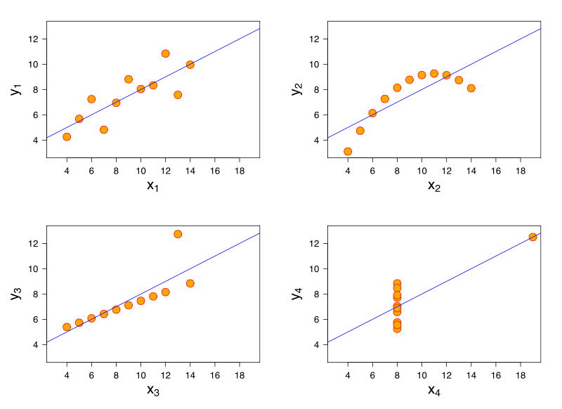
Let’s Look at Some Data…Visually
“Anscombe’s Quartet”
Source: Wikipedia
Notes:
Here are these same four data sets, plotted visually, with trend lines.
Now, what’s your move?
What other pieces of information might you want?
It would be nice to be able to encode some of that information on these graphs, like maybe have a larger circle for stores that offer, on average, larger discounts, or to be able to quickly split this data up to show sales by product category by store. Like, maybe with just one click. And then it would be nice to be able to share this view with your individual store managers, with just a couple of clicks. And it would be nice to have that view you shared update with real-time data, so those store managers could see day-by-day how their stores were performing compared to their peers, and interact with that live data to understand why their stores are succeeding or lagging. So that they are each empowered to explore the information they need to meet and exceed their profit goals.
That’s what Tableau does.

Slide 31
"It’s a common mistake to think that charts are just a fancy way of showing numbers. They’re not. They’re tools for understanding."
Robert Kosara
Senior Research Scientist
Tableau
Notes:
We are not in the business to make pretty charts.

Slide 32
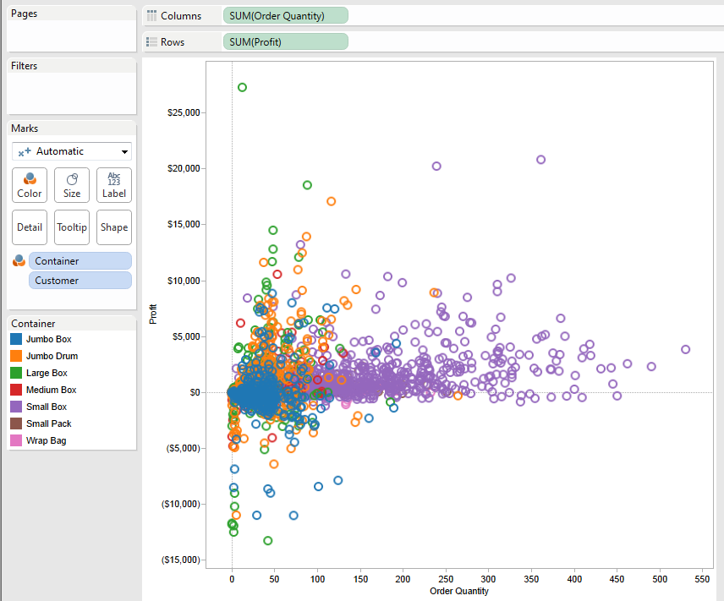
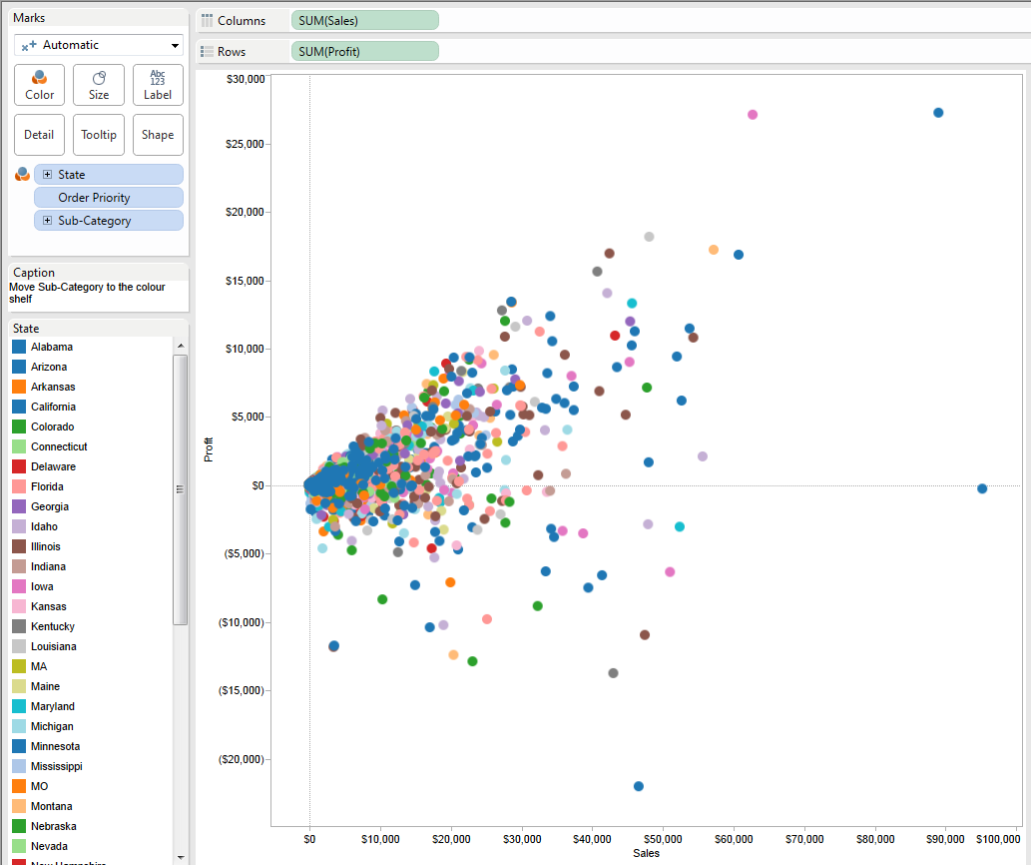
Color 6 is manageable; 8 is the maximum
Useful
Useless
Notes:
Too many colours, anything more than 7(+-2) becomes an issue for us to distinguish
Miss out on the pre-attentive access
6 colours very manageable for our brain to differentiate

Slide 33
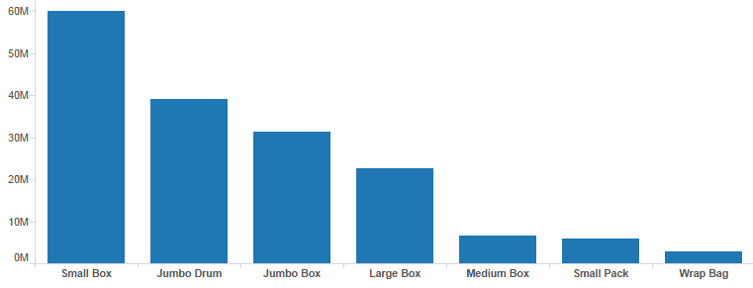
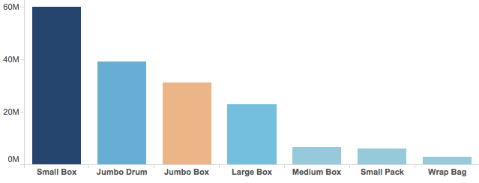
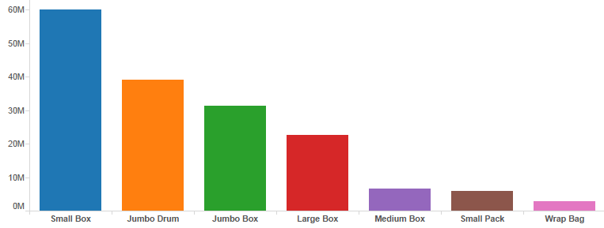
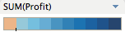
Color encoding
Double encoding (labels and color) is a bad idea to distinguish categorical elements
Useful
Useless
Notes:
labels are good enough to distinguish categorial elements
can add additional encoding for quantitative data i.e. profit
Bright colors can cause sensory overkill. They should be reserved for data that stands out from the rest.

Slide 34
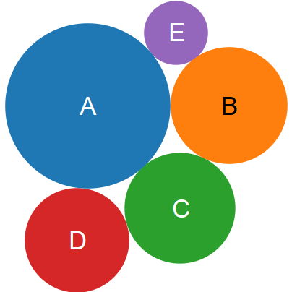
Size
Rank B, C and D?

Slide 35
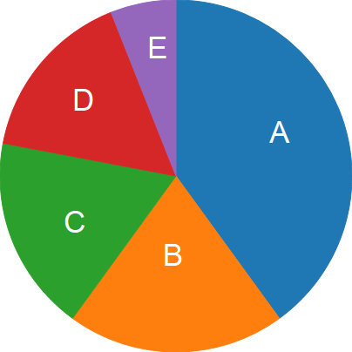
Angle
Rank B, C and D?

Slide 36
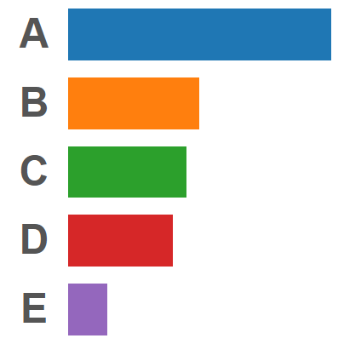
Length
Rank B, C and D?

Slide 37
1. Human Visual Perception 2. Visual Best Practice 3. Visual Analysis 4. Good Dashboard Design 5. Guided Analytics

Slide 38
Research tells us…
QUANTITIVE | ORDINAL | CATEGORICAL
Position Length Size Color intensity | Position Color intensity Size Different colors Different Shape | Position Different colors Shape
effectiveness
Notes:
Quantitative: numerical (weight, sales, profit)
Ordinal: If an ordering exists (medals, rankings, income levels)
Categorical (Nominal): no natural order between the categories (names, product categories, countries)

Slide 39
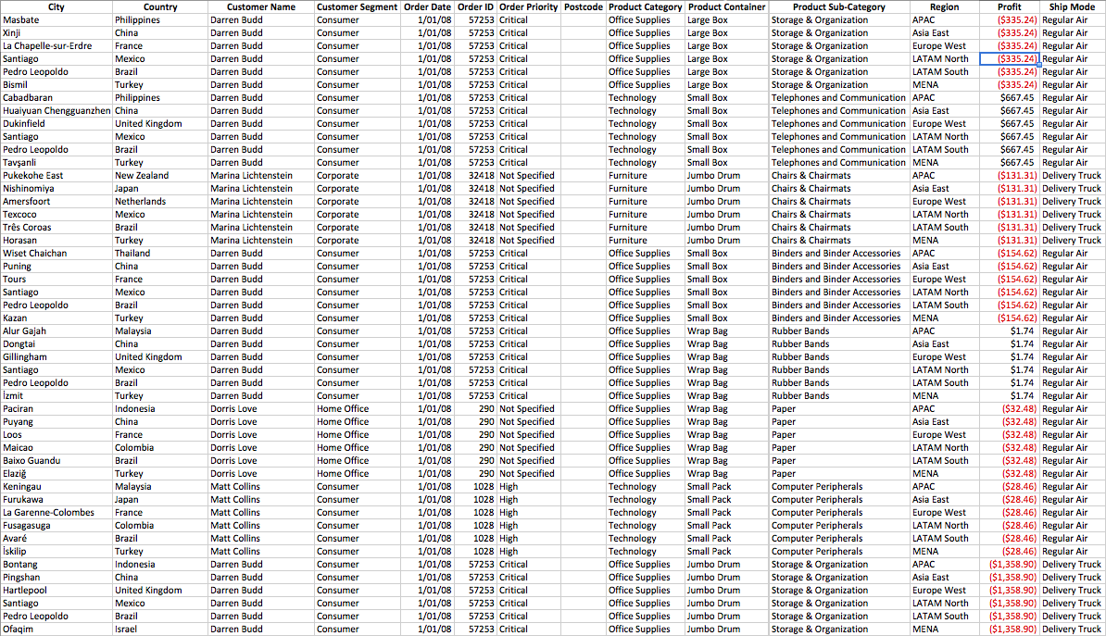
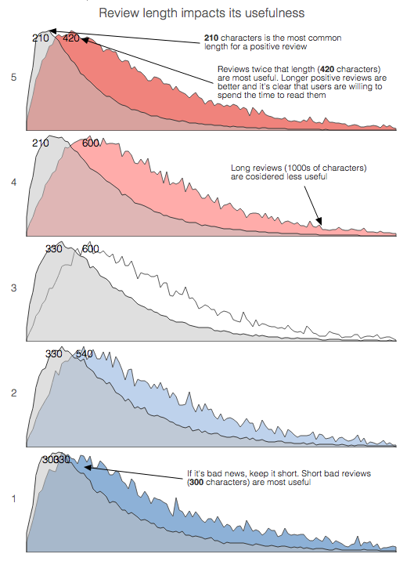
How do humans like their data?
For machine to read
For human to understand

Slide 40
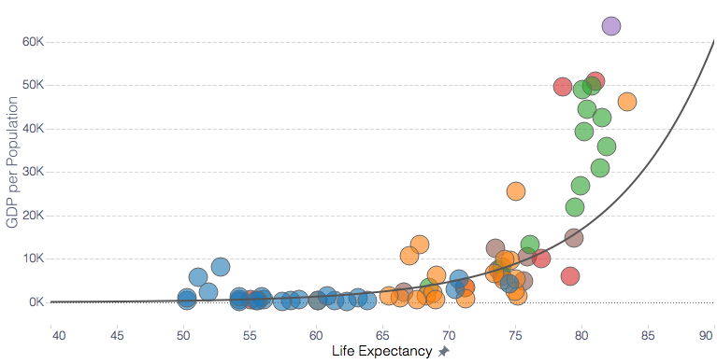
Relationship on scatter plot
Notes:
RELATIONSHIPS: Scatter plot. Unsurprisingly, countries with more money per person tend to have longer lifespans.

Slide 41
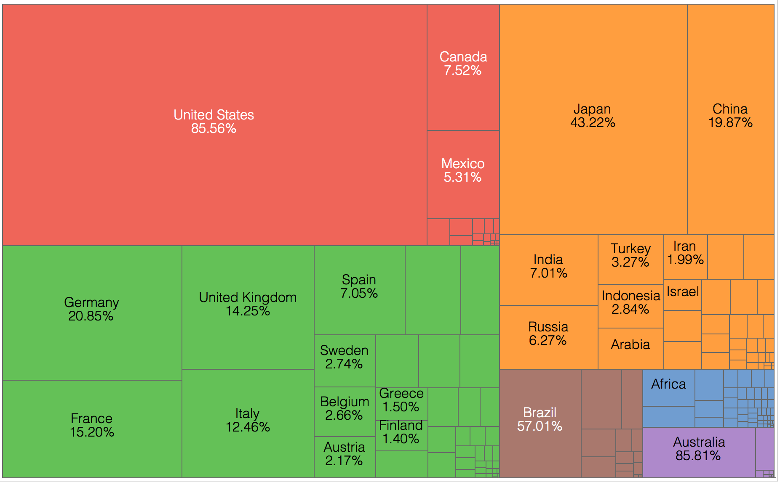
Relative proportion on tree map
Notes:
RELATIVE PROPORTIONS: Treemap. Quickly see how continents relate, and also the members in those area.

Slide 42
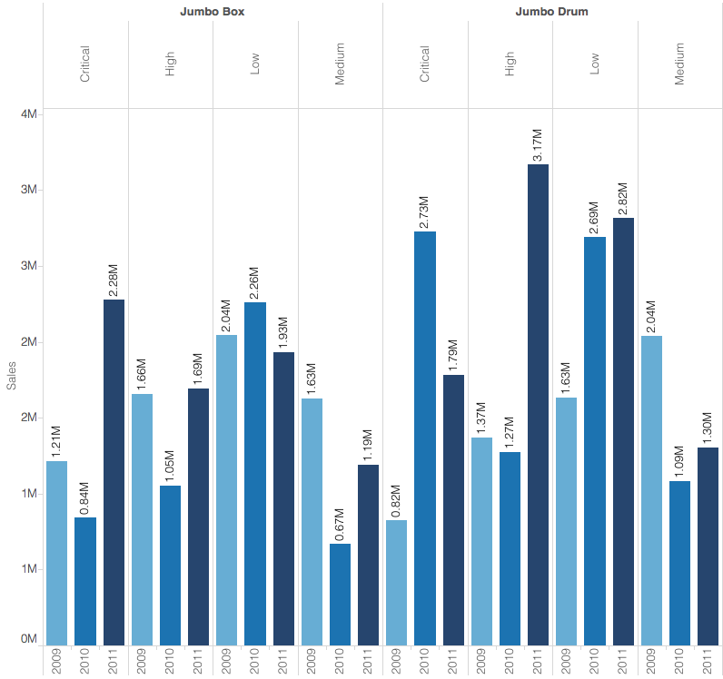
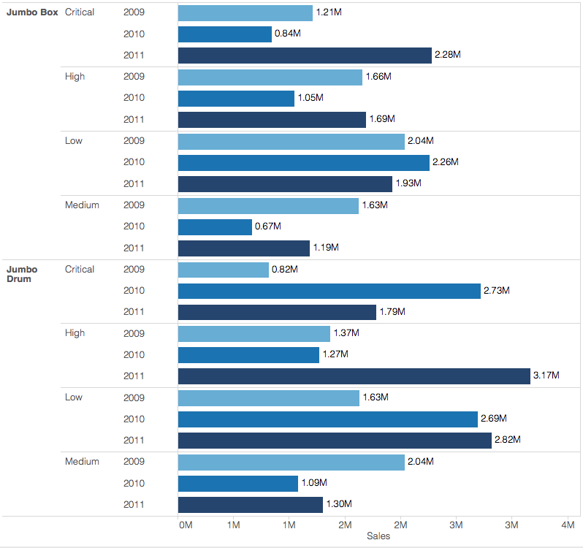
Text orientation horizontal
Notes:
Orient text so it’s easily read
We are much better at reading it horizontally than vertically

Slide 43
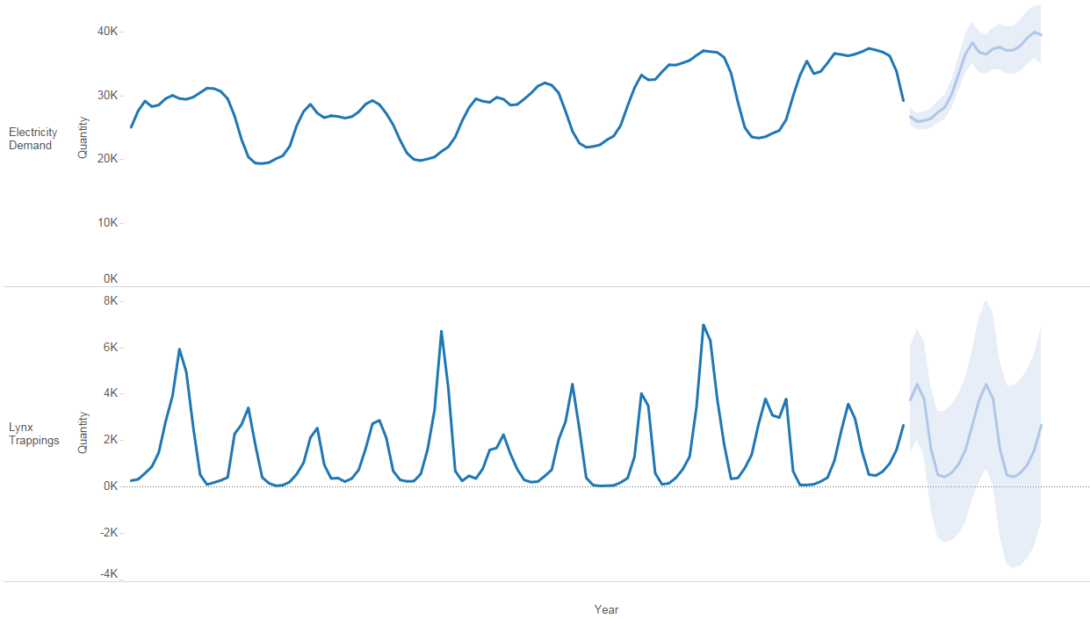
Trends, patterns, outliers on line chart

Slide 44
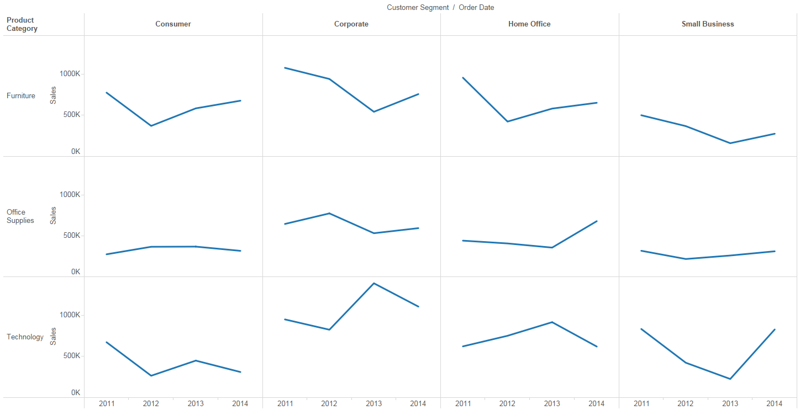
Compare on small multiples
Notes:
In a display of small multiples, the same basic graph appears multiple times, each
By arranging multiple versions of the same graph next to one another you can show the entire picture within eye span, making comparisons easy.

Slide 45
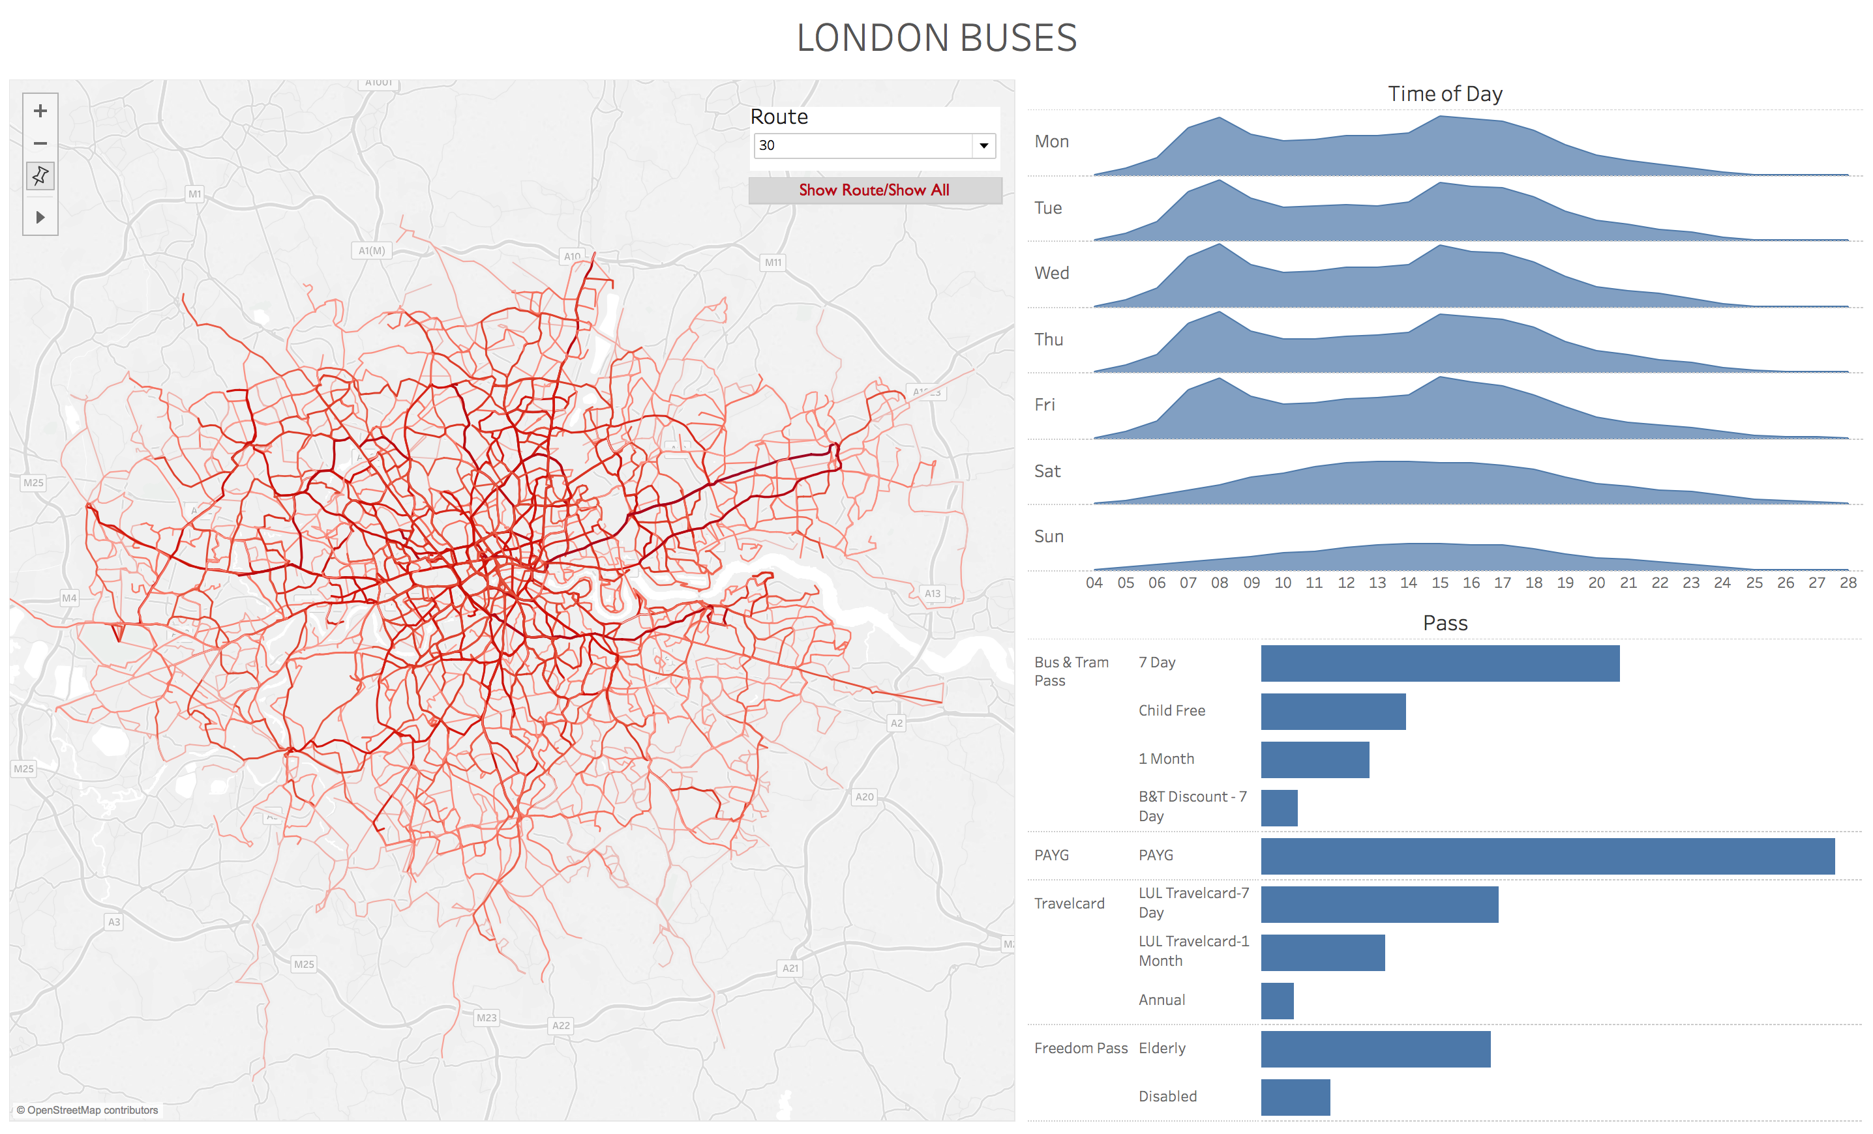
Location on map Compare values on bar chart
Time on horizontal axis
Notes:
In addition to an understanding of our hardwired pre-attentive visual attributes and the way we assign importance, being sensitive to other sensing pitfalls – like the difficulty visual interruption presents – is important.
So too are standards – time on the x-axis, location on a map, a using a bar char to compare values.
In this dashboard it’s easy to understand the area (size/scope) of the data, the time frame (day of the week, the work day) and what we’re comparing (different ticket types)
The red makes the data pop but it’s not overly complicated with different colors that would only confuse the viz – for example, marking the days of the week in in alternate colors would be meaningless here.

Slide 46
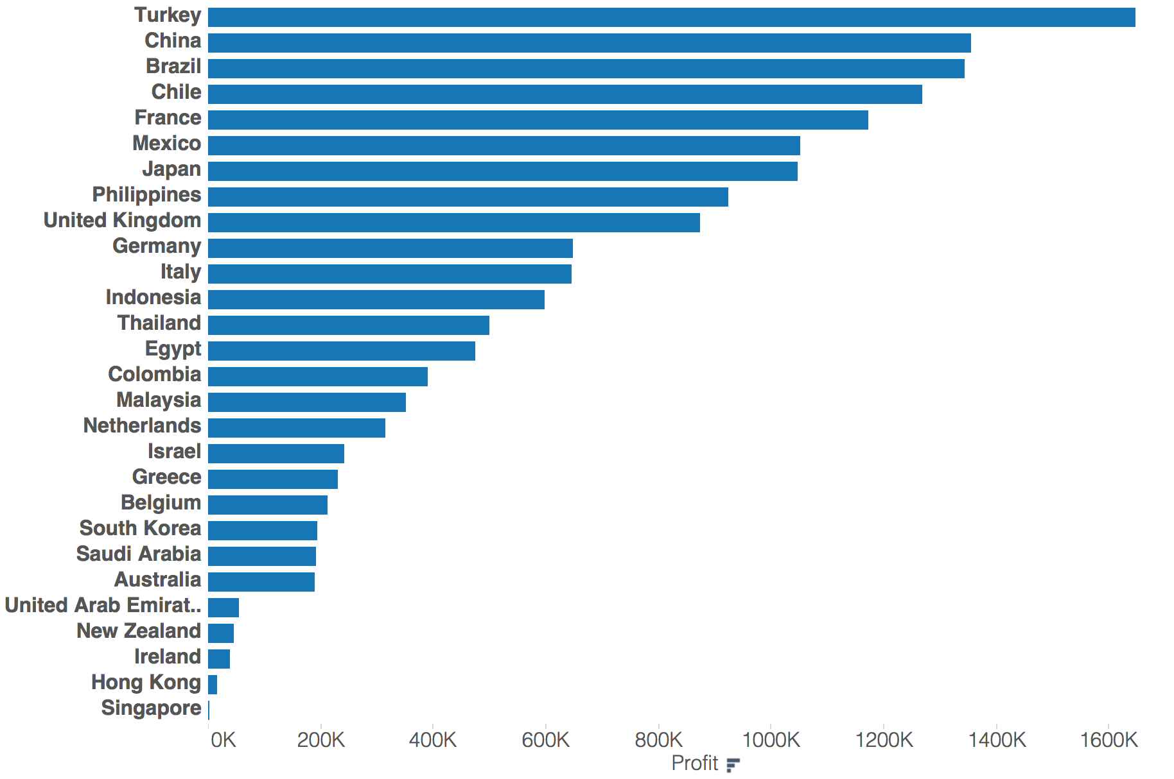
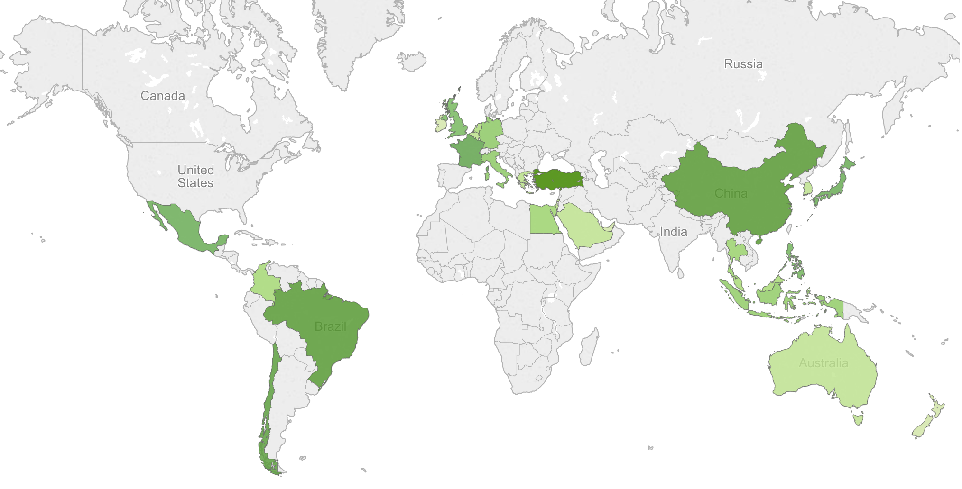
Location on map Compare values on bar chart
Use a bar chart instead of map if order is important

Slide 47
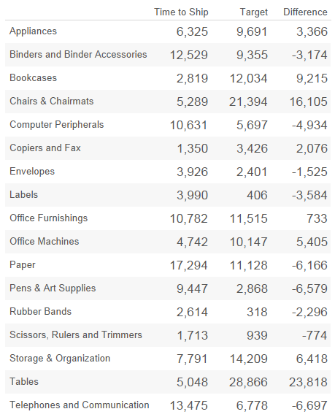
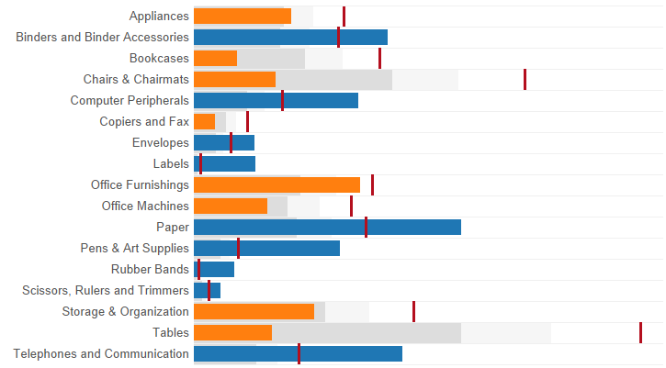
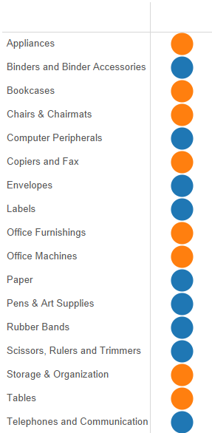
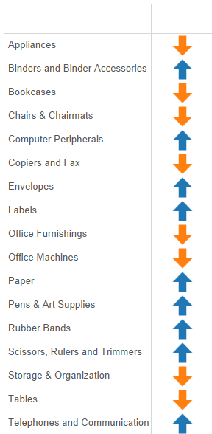
Context: comparing 2 values on bullet chart
forcing users to read
visually see by how far we met or missed the target
Notes:
It’s very difficult to see the numbers in context
Adding traffic light indicators shows the difference but still does not show the context, forcing users to read the numbers
Arrows are of little help
Bullet graphs are an excellent way of visually comparing two measures against each other. Such as, budget vs actual.
I can visually see by how far we met or missed the target

Slide 48
1. Human Visual Perception 2. Visual Best Practice 3. Visual Analysis 4. Good Dashboard Design 5. Guided Analytics

Slide 49
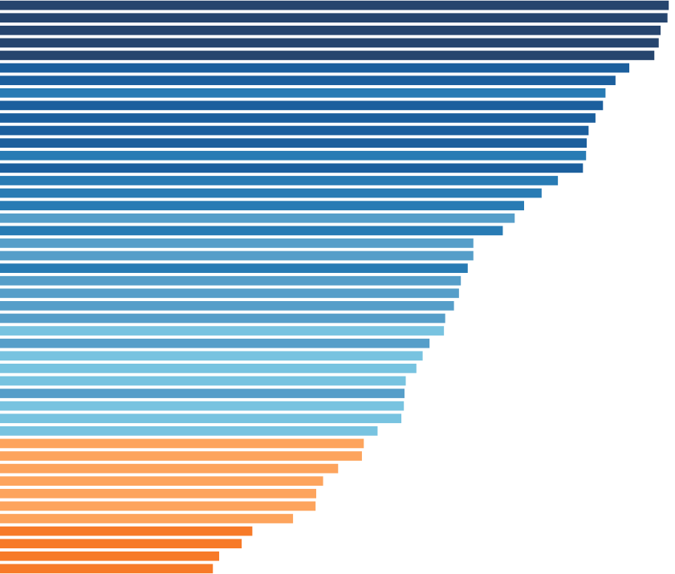
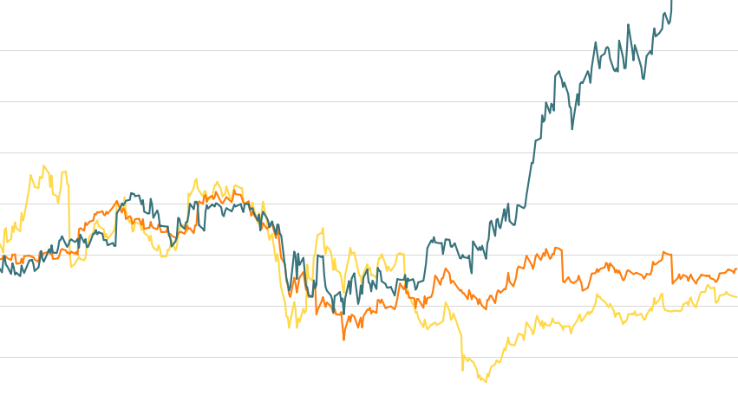
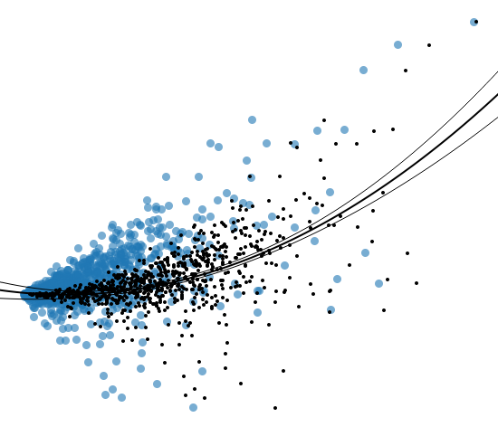
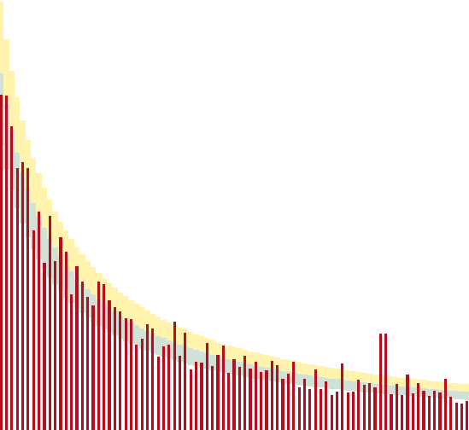
Time Series Analysis
Part to Whole Analysis
Correlation Analysis
Distribution Analysis

Slide 50
Time Series Analysis
Trends
Variations/Exceptions
Rate of Change
Co-variation (Leading/Lagging Indicators)
Line Charts (or Line + Bar)
Notes:
Drill-in/out
Moving Averages
Rate of Change
Use Log Scales/Percentages
Cycle Plots
Trellis Chart/Small Multiples/Heatmap

Slide 51

Part to Whole Analysis
Parts and Whole
Ranks
Pie Charts vs Bar
Pareto
Notes:
Groupings, Sorting
Change baseline of scale
Bump Charts

Slide 52
Correlation Analysis
Direction – Positive/Negative
Strength – Correlation Coefficient
Shape – Linear/Curved/Outliers
Scatter Plots
Notes:
Optimize aspect ratio
Reduce over plotting
Transparency
Remove fill
Trellis or Small Multiples
Remove rough(outliers) to see the smooth
Trend Lines, Reference Lines

Slide 53
Distribution Analysis
Spread
Center
Shape
Histograms and Box Plots
Notes:
Choose right intervals
Use Median or Percentiles, resistant to outliers

Slide 54
Summary
Analysis | Visualizations
Time Series | Line, Line + Bar, Circle
Part in Whole | Bar, Bullet Chart
Correlation | Scatter Plot
Distribution | Histogram, Box Plots

Slide 55
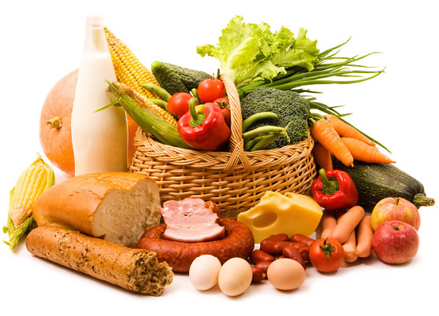
Market Basket Analysis
See buying patterns
Create a self-join
Heat map or Highlight map

Slide 56

Cohort Analysis
Analyze the trend of a cohort or group of consumers
Create a cohort group, for example first time customers

Slide 57
1. Human Visual Perception 2. Visual Best Practice 3. Visual Analysis 4. Good Dashboard Design 5. Guided Analytics

Slide 58

What’s your story?

Slide 59
“A dashboard is a visual display of the most important information needed to achieve one or more objectives; consolidated and arranged on a single screen so the information can be monitored at a glance”
Stephen Few
Author
Information Dashboard Design
Notes:
What is a dashboard?

Slide 60
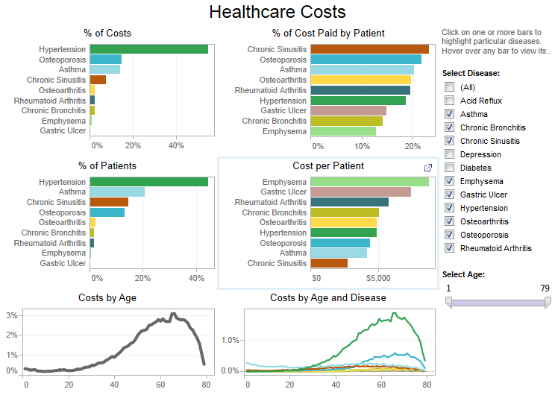
Dashboards
Dashboards should pass the 5-second test

Slide 61
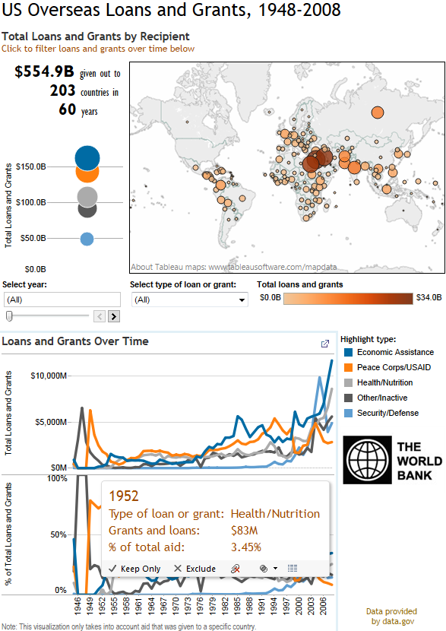
5
Proper header and instructions
1
Most important view goes on top or top-left
6
Use 5 views or fewer in dashboards
2
Provide interactivity for user discovery
7
Legends go near their views
3
At-a-glance : no scroll
8
Consistent colors
4
Data Ink Ratio
Minimal color
9
Make use of tooltips

Slide 62
1. Human Visual Perception 2. Visual Best Practice 3. Visual Analysis 4. Good Dashboard Design 5. Guided Analytics

Slide 63

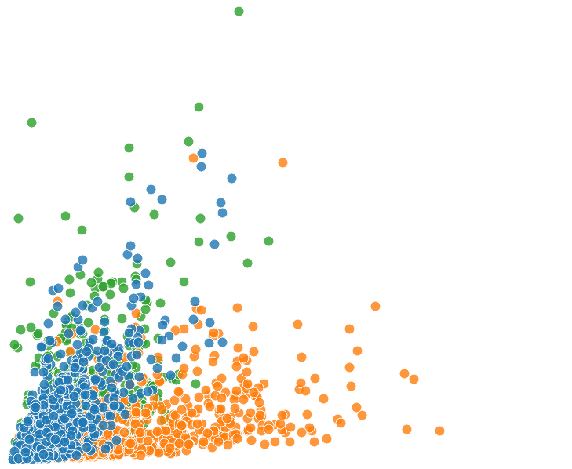
Telling a story to drive a point

Slide 64

Guided Analytics – Tell your story
View
View
Weaving the story
View
•Trends
•Outliers
•Correlation
Your Point
View
View
View
• Drill-in /through• Filter • Highlight
• Annotations •URL
Reduce.

Slide 65

Questions?
Notes:
Our hope is that with Tableau, data looks very different to you– not a brick wall, but a road that leads you to new opportunities. .

Slide 66
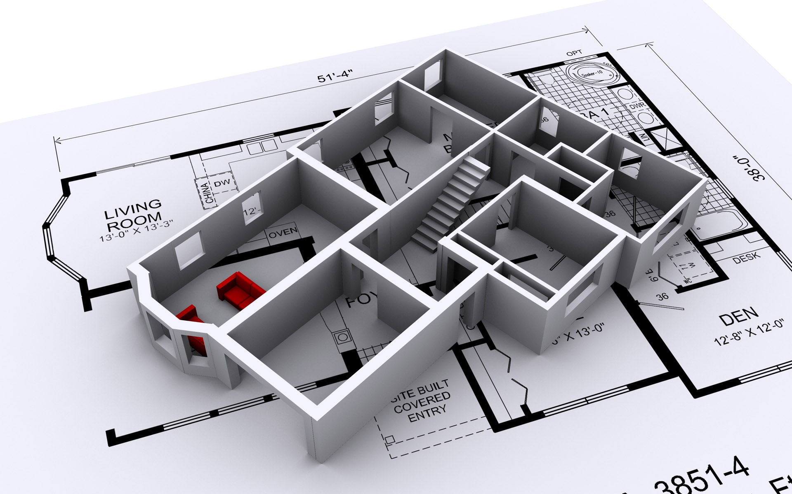
Workshop
Notes:
Our hope is that with Tableau, data looks very different to you– not a brick wall, but a road that leads you to new opportunities. .
https://public.tableau.com/profile/liangbeibei212#!/vizhome/20160615SHViz/GettingMoreYesinSpeedDating

